Slide 1
Filing Status
Pub 17, Chapter 2
Pub 4012, Tab B
NJ 1040 Instructions
NJ Special Handling Document on TaxPrep4Free.org
www.state.nj.us/treasury/taxation
(1040 lines 1-5)
(NJ 1040 lines 1-5)
Notes:
1

Slide 2
Filing Status Is Based on 3 Criteria
Marital status on last day of tax year
“Married” means legally married under laws of any state or country
Federal law does not include civil unions or domestic registered partners as married
NJ law includes civil union partners in Married statuses, but does not include domestic registered partners as married
Persons living in home
May or may not be dependents
Who pays to keep up the home
Notes:
2

Slide 3
Choice of Five Filing Statuses Federal & State Similar With Some Differences
Federal Filing Status | State Filing Status
Single | Single
Married Filing Joint (MFJ) * | Married/Civil Union Filing Jointly *
Married Filing Separate (MFS)* | Married/Civil Union Filing Separately *
Head Of Household (HOH) | Head Of Household (HOH)
Qualifying Widow/er (QW) | Qualifying Widow/er /Surviving Civil Union Partner
* Married same-sex couples treated as Married filing status
Civil union filing statuses out of scope

Slide 4
To Determine Filing Status, Do an Analysis Of Living Situation
Use information from Intake/Interview Sheet, Part II
Taxpayer-completed info on people who lived with them
Answers to questions in shaded section that counselor completes based on interview
Determine:
Marital status as of December 31
Who was living in the home during the year
Their relationship/dependency
Who paid more than half the cost of keeping up the home
Date of death if either/both spouse(s) deceased
Use one of filing status tools on next slides to determine correct filing status
Notes:
4

Slide 5
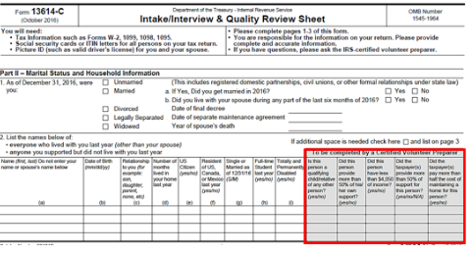
Intake/Interview Sheet, Part II
Notes:
5

Slide 6
Useful Tools For Determining Filing Status
 | Tool
Determination of Filing Status | Filing Status Wizard in TaxSlayer
 | Determination of Filing Status Decision Tree in Pub 4012 Tab B
 | Determination of Filing Status Decision Tree in laminated resource tool
 | Via TaxPrep4Free.org link: Use automated tool available on IRS.gov called Interactive Tax Assistant “ITA”

Slide 7
Useful Tools For Determining Qualifying Person
 | Tool
Determination of Qualifying Person | Tables for Qualifying Child and Qualifying Relative Dependency Exemptions in Pub 4012 Tab C
 | Qualifying Child and Qualifying Relative Flow Charts in laminated resource tool
 | Via TaxPrep4Free.org link: Use automated tool available on Preparer page Qualifying Child/Qualifying Relative Flowchart Tool
 | Via TaxPrep4Free.org link: Use automated tool available on IRS.gov called Interactive Tax Assistant “ITA”

Slide 8
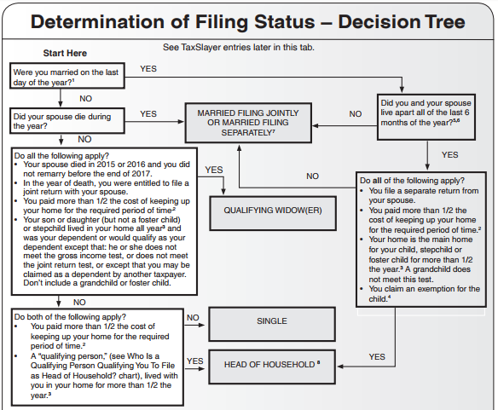
2017 Filing Status Determination
Pub 4012 Tab B
Don’t forget to consult footnotes
Notes:
8
Show students Filing Status Decision Tree in Pub 4012 Tab B

Slide 9
Single (S)
Not married on December 31 of current tax year
Although these situations appear to be single, they actually qualify for other filing statuses:
If widowed in either of two prior tax years, with qualifying dependent, and not remarried, select Qualifying Widow(er) (QW)
If widowed in current tax year and not remarried, select Married Filing Jointly (MFJ)
If maintained home for qualifying child or qualifying relative, select Head of Household (HOH)
Notes:
9

Slide 10
Married Filing Joint (MFJ) – (Lowest Tax Rate)
If married on December 31, considered married for entire year
Now includes married same-sex couples
Common law marriage if recognized in the state where it began
Common law marriage not recognized if began in NJ
Spouse died during tax year & taxpayer did not remarry
Notes:
10
Note: States that recognize common law marriage include: Alabama, Colorado, Kansas, Rhode Island, South Carolina, Iowa, Montana, Utah, Texas and the District of Columbia

Slide 11
NJ Filing Status Civil Union - Out of Scope
NJ 1040 Instructions
Civil Union status
Requires a license
Grants same state benefits, protection & responsibilities of married couples
Must be at least 18 years of age, or meet requirements for exceptions
Civil union status not treated as Married on Federal return
NJ treats civil union status like equivalent Married status (MFJ/MFS)
No easy way to use software to file different filing statuses for Federal and NJ, so return is Out of Scope
Note: NJ Recognizes Domestic Partners (different than Civil Union) as dependents, and allows a dependent exemption in certain circumstances. This is In-Scope
Covered in later module
Notes:
Civil union returns are Out of Scope because filing status for Federal and NJ returns would be different. No easy way to do this in TaxSlayer
Eligibility for Civil Union:
Must not be in another civil union, domestic partnership or marriage in this state or that is recognized by this state
Be of the same sex; and
Be at least 18 years of age, or meet requirements for exceptions
Not closely related (descendent, sibling, aunt, uncle, niece or nephew)
Benefits-State based rights:
Eligible for Family Leave
Joint ownership of property
State employees-guaranteed insurance, health and pension benefits to partner
Inheritance rights
Responsibilities:
Liable for partners debts
Obligation for support of other partner during CU or after CU Termination, like marriage
In cases of Civil Union……….On TaxSlayer ……answering the questions on NJ 1040 p. 3 top :
“If filing with a CU partner or as a surviving CU partner, check one of the following”
o CU couple filing joint return o CU couple filing separate return o Surviving CU partner
This helps determine what box to check off under Filing status

Slide 12
Married Filing Separate (MFS) – (Highest Tax Rate)
Taxpayer chooses to file MFS
Show spouse name/SSN on return
If one spouse itemizes, other spouse must also itemize
First to file sets standard; return of 2nd to file could reject if not in sync
If taxpayer didn’t live with spouse last 6 months but provided home for dependent child, select HOH rather than MFS
Notes:
12
There are cases where each filing MFS instead of MFJ can produce better total result
e.g. - one spouse has high medical expenses. Might be able to reach 7.5% threshold on one income in order to deduct on Schedule A, but can’t reach threshold on joint income
e.g. - there is a lien on one of the spouses assets
e.g. - separation of tax liability from spouse’s
e.g. - lower overall tax bill If one spouse has a significant itemized deduction

Slide 13
MFS – Disadvantages on Federal Return
Highest tax rate/lower standard deduction and cannot claim:
Earned Income Credit (EIC),Child Tax Credit (CTC), or Child & Dependent Care (CDC) credit
Education credits
Student loan interest deduction
No tax-free exclusion of Social Security or US bond interest
Capital loss limited to $1,500 (not $3,000)
Premium Tax Credit under Affordable Care Act
Notes:
13

Slide 14
MFS – Disadvantages on Federal Return
(cont’d)
When taxpayer lived with spouse anytime during year:
Taxable income must include 85% of Social Security & RR Benefits received
Cannot claim Credit for the Elderly or the Disabled
Cannot roll over Traditional IRA to Roth IRA
Notes:
14

Slide 15
Head Of Household (HOH)
Pub 4012 Tab B
Must have a “qualifying person” as defined in 4012 Page B-10 chart
Qualifying Child Dependent or
Qualifying Relative Dependent
Must have paid more than ½ the cost of keeping up your home in tax year
Qualified Person lived with you for more than ½ the year
Child is considered to have lived with you all year if born or died during year
Qualifying relatives who are parents may live elsewhere (includes Canada & Mexico) as long as you paid over 50% of cost of living expenses

Slide 16
Head of Household (HOH) Qualifying Person Chart
Pub 4012 Tab B
Rules for qualifying person for HOH not exactly the same as for Dependency
Notes:
See Pub 4012 Tab B chart to determine “Who is a qualifying person qualifying you to file as HOH?”
Rules for qualifying person for HOH filing status are not exactly the same as rules for Dependency
Always use charts in Pub 4012 to determine HOH qualifying rules &/or Dependency qualifying rules
QC/QR laminated tool (or online version via TaxPrep4Free.org) can be very helpful here
IRS.gov site has a tool to help determine filing status & dependents:
“Interactive Tax Assistant”. Link available on TaxPrep4Free.org Preparer page
16

Slide 17
Head Of Household (HOH) If Unmarried or Legally Separated
Pub 4012 Tab B
Rules become more complicated when parents are
Unmarried
Divorced
Separated
Counselors should consult Pub 4012 Tab B Qualifying Person chart and footnotes. Support and Divorce agreements should also be considered
See also TaxSlayer Filing Wizard or IRS online ITA or Tax-Aide QC/QR Tool
17
Notes:
17

Slide 18
Head Of Household (HOH) If Married but Lived Apart
Pub 4012 Tab B
Lived apart last 6 months
Provided over 50% cost of maintaining home
Was main home for your child, adopted child, stepchild, or eligible foster child for over 6 months
No other relatives qualify to claim exemption
Notes:
18

Slide 19
Maintaining a Household
NEW RULINGS IN 2017; CAN BE APPLIED TO ANY OPEN TAX YEARS
May treat home’s fair market rental value as a cost of maintaining a household, instead of the sum of payments for mortgage interest, property taxes, and insurance
In certain circumstances, annual cost of maintaining a household when a qualifying child or dependent resides in household for less than the entire tax year may be prorated on a monthly basis
In certain circumstances, a new household may be created during a year
In certain circumstances, shared living quarters can be treated as separate households
Notes:
19

Slide 20
Maintaining a Household Examples
Child moves in or out during year
Prorate the annual cost of keeping up the home by the number of months the child lived there
Taxpayer must have paid ½ the prorated cost
Spouses separate and one moves out
New household begins on date of move
Taxpayer must have paid ½ the cost of keeping up the home beginning with date of move
Multiple households in same living quarters
Only if no one in household A would win tie-breaker for anyone in household B
Notes:
20

Slide 21
Maintaining a Household Examples
(cont’d)
One example would be an unmarried couple, each with own child, each pays more than ½ cost for self and child. Each can claim HoH because neither adult would win tie-breaker for other’s child
If situation was unmarried couple with 2 children together, each pays more than ½ the cost for self and one child, only one could claim HoH. Parent with higher AGI would win tie-breaker for both children
Lower AGI adult could be Single with one dependent
Another example is grandparent, parent, and 2 children live together, each adult pays more than ½ cost for self and one child. Grandparent cannot claim HoH for one child while parent claims HoH for second child, because parent would win tie-breaker
Grandparent could be Single with one dependent
Notes:
21

Slide 22
Qualifying Widow/Widower (QW)
Spouse died in one of two years prior to current Tax Year
Can file MFJ in current tax year, then QW for 2 years, then file HOH or single thereafter
Has a child, stepchild, or adopted child who qualifies as a dependent OR
would qualify as a dependent except *
he/she does not meet the gross income test
he/she does not meet the joint return test
the taxpayer can be claimed as a dependent by another taxpayer
* NEW RULING IN 2017; CAN BE APPLIED TO ANY OPEN TAX YEARS
Provided over 50% of the cost of maintaining a home which was child’s main home for the entire year
NOTE: Entitled to file MFJ if spouse died after end of current tax year (e.g. for TY2016, spouse died in early 2017)
Notes:
22
After someone dies, a final return must be filed by surviving spouse or executor

Slide 23
Qualifying Widow/Widower (QW) Scenarios
Spouse died in current tax year (e.g. for TY2016, spouse died in 2016 or before filing in 2017)
If not remarried in current tax year, file MFJ with deceased spouse
If remarried, file MFJ with new spouse; deceased spouse files MFS
Spouse died in either of two prior years and not re-married (e.g. for TY2016, spouse died in 2014 or 2015)
With qualifying dependent, file QW
With no qualifying dependent, file S
Spouse died more than two years ago (i.e. for TY2016, spouse died 2013 or earlier)
File S or HOH
Notes:
23

Slide 24
Filing Status Importance
Pub 4012 Tab B
Many tax items affected by filing status
Necessity to file a return
Pub 4012 Page A-1 Chart A
Standard deduction
Pub 4012 Page F-1 Exhibit 1
Tax rate bracket
Eligibility for certain credits
Pub 4012 Page I-3 Step 3
Notes:
24

